Slide 1
Session 4
© 2017-18 KL University – The contents of this presentation are an intellectual and copyrighted property of KL University. ALL RIGHTS RESERVED

Slide 2
Enhanced Entity Relationship (EER) Model

Slide 3
The Entity (Review)
Entity Relationship (ER) Model – represents an object
  Physical – person, car
  Conceptual – school, company
ER model is based on the perception of the real world as a collection of objects with attributes
Attributes – describe the entity
  Single, Multi-value
  Composite, Simple
  Derived, Stored

Slide 4
What is an EER Model?
Enhanced Entity Relationship (EER) – Data Modeling
EER shows complex relationships between objects in a database (multimedia, geographical).
Concepts of subclasses and superclasses, specializations and generalizations.
Put concepts in diagram to form EER model

Slide 5
Specialization
Subgrouping into subclasses (top-down approach)
Example: EMPLOYEE -> SECRETARY MANAGER, etc.
Inheritance – Inherit attributes and relationships from superclass (Name, Birthdate, etc.)
Subclasses may have uniqe attributes
  SECRETARY has TypingSpeed attribute, MANAGER has BusinessUnitManaged, etc.

Slide 6
Specialization (cont.)
SSN
Name
EMPLOYEE
JobType
PayMethod
WORKS_IN
U
DEPARTMENT
U
SECRETARY
ENGINEER
U
U
U
SALARY_EMP.
HOURLY_EMP.
SOFTWARE_ENGINEER

Slide 7
Model Shapes
When you have more than one subclass based on the same defining attribute (JobType), use
To show class/subclass relationships, use
  Used for relationships between entity types
To show relationship between two different entity types, use
U

Slide 8
Generalization
Reverse processes of defining subclasses (bottom-up approach)
Bring together common attributes in entities
Example: CAR (with attributes color, price, max speed) and TRUCK (with attributes color, price, tonnage) can be generalized into VEHICLE (with attributes color and price).

Slide 9
Hierarchies and Lattices
Hierarchy – subclass participates in one class/subclass relationship
EMPLOYEE
SOFTWARE ENGINEER has all the attributes of an ENGINEER and EMPLOYEE
U
U
SECRETARY
ENGINEER
U
SOFTWARE ENGINEER

Slide 10
Hierarchies and Lattices
Lattice – subclass participates in more than one class/subclass relationship
ENGINEERING MANAGER (shared subclass) is a MANGER and an ENGINEER
EMPLOYEE
U
U
U
SECRETARY
ENGINEER
MANAGER
U
U
ENGINEERING MANAGER

Slide 11
Categories
Models a class/subclass with more than one superclass of distinct entity types. Attribute inheritance is selective.
PERSON
BANK
COMPANY
The category, OWNER, is a subclass of the union of PERSON, BANK, and COMPANY. OWNER is either a PERSON or a BANK or a COMPANY
U
U
OWNER

Slide 12
Constraints
Disjoint – an entity can be a member of at most one subclass of a specialization
Overlap – an entity may belong to more than one subclass of a specialization
Total specialization – each entity of a superclass belongs to some subclass of a specialization
Partial specialization – each entity of a superclass does not have to belong to some subclass of a specialization
d
o

Slide 13
Putting It All Together
Example (Figure 4.7 in textbook)

Slide 14

Specialization / Generalization Lattice Example (UNIVERSITY)
Slide 4- <number>

Slide 15
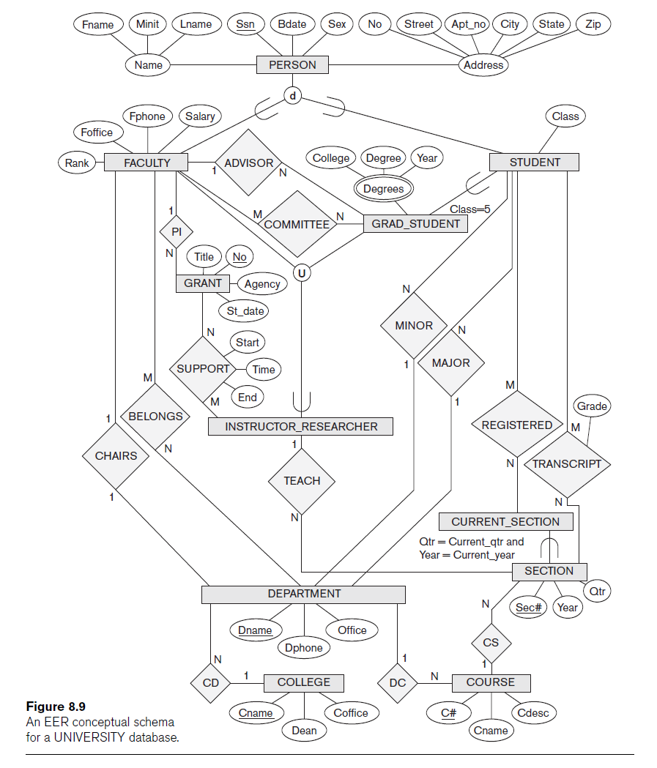
Union

